Slide 1
Mobile Meets IoT: Engagement for an Open Economy
Eric Goldman Jay Langhurst
Senior Software Engineer, IT, Salesforce Principal Solution Architect, IT, Salesforce
egoldman@salesforce.com jlanghurst@salesforce.com
@boilrup @jaylanghurst
Notes:
MobilePush is one word, referred to as Mobile App Engagement

Slide 2
Safe Harbor
Safe harbor statement under the Private Securities Litigation Reform Act of 1995:
This presentation may contain forward-looking statements that involve risks, uncertainties, and assumptions. If any such uncertainties materialize or if any of the assumptions proves incorrect, the results of salesforce.com, inc. could differ materially from the results expressed or implied by the forward-looking statements we make. All statements other than statements of historical fact could be deemed forward-looking, including any projections of product or service availability, subscriber growth, earnings, revenues, or other financial items and any statements regarding strategies or plans of management for future operations, statements of belief, any statements concerning new, planned, or upgraded services or technology developments and customer contracts or use of our services.
The risks and uncertainties referred to above include – but are not limited to – risks associated with developing and delivering new functionality for our service, new products and services, our new business model, our past operating losses, possible fluctuations in our operating results and rate of growth, interruptions or delays in our Web hosting, breach of our security measures, the outcome of any litigation, risks associated with completed and any possible mergers and acquisitions, the immature market in which we operate, our relatively limited operating history, our ability to expand, retain, and motivate our employees and manage our growth, new releases of our service and successful customer deployment, our limited history reselling non-salesforce.com products, and utilization and selling to larger enterprise customers. Further information on potential factors that could affect the financial results of salesforce.com, inc. is included in our annual report on Form 10-K for the most recent fiscal year and in our quarterly report on Form 10-Q for the most recent fiscal quarter. These documents and others containing important disclosures are available on the SEC Filings section of the Investor Information section of our Web site.
Any unreleased services or features referenced in this or other presentations, press releases or public statements are not currently available and may not be delivered on time or at all. Customers who purchase our services should make the purchase decisions based upon features that are currently available. Salesforce.com, inc. assumes no obligation and does not intend to update these forward-looking statements.

Slide 3
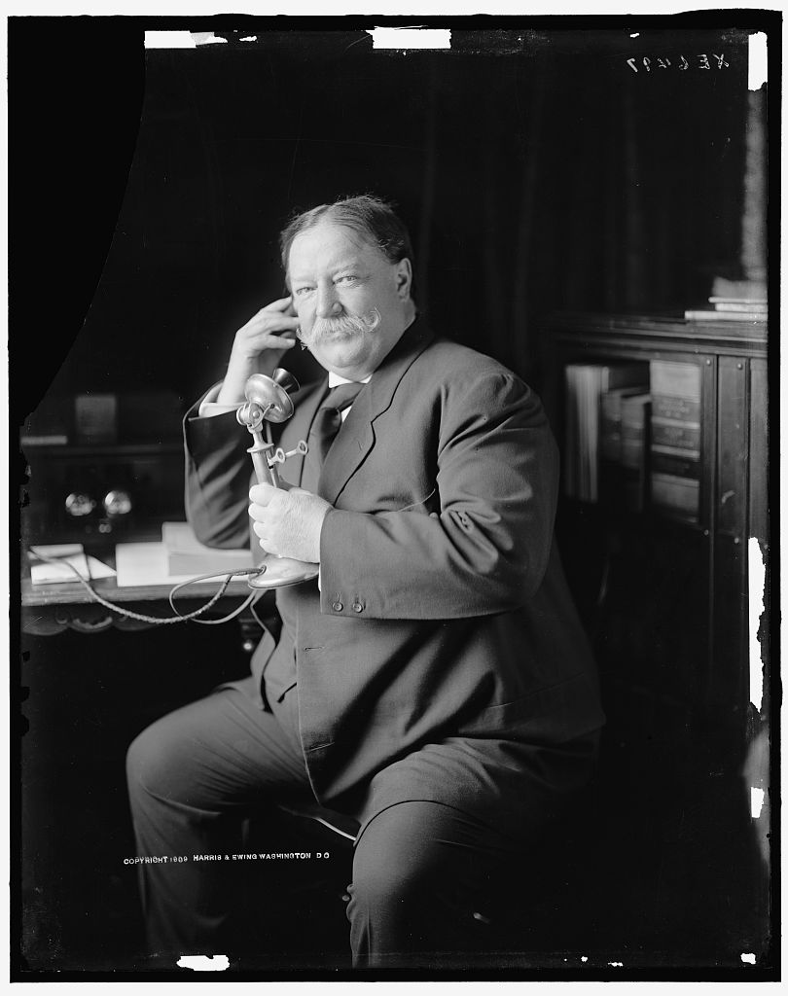
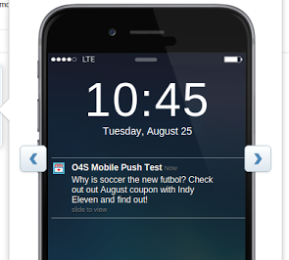
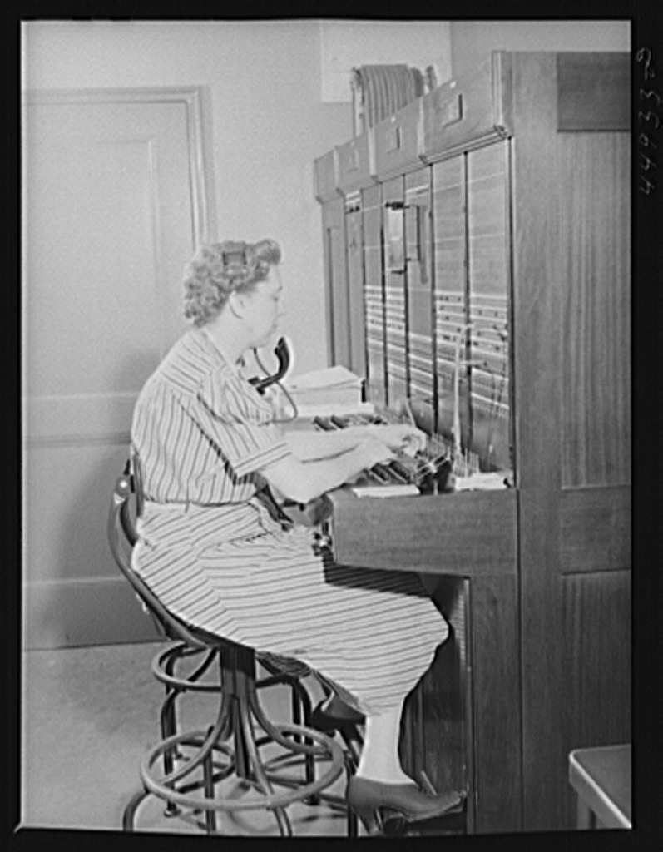
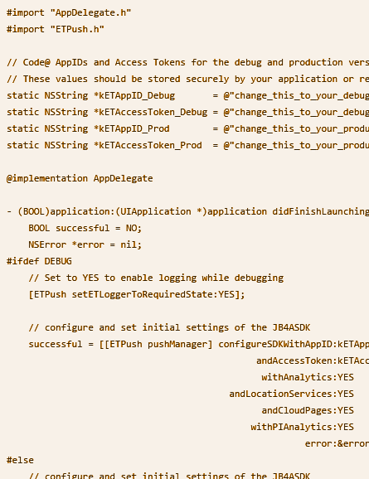
To the Code!
What will we demonstrate?
Integrating Mobile Push SDK
Composing a Mobile Push
Old Timey IoT Fun!
Getting Started
Putting it all together
Internet of Rotary Phones (IoRP)
Notes:
Eric - Ask Reid/Kevin if it is Journey Builder for Apps (JBA) or Mobile Push SDK?
Eric - Add pictures of code screenshot/etc for each of 3 areas
DONE - Jay add Mobile Push/IoT photo - http://www.loc.gov/item/hec2009001847/

Slide 4
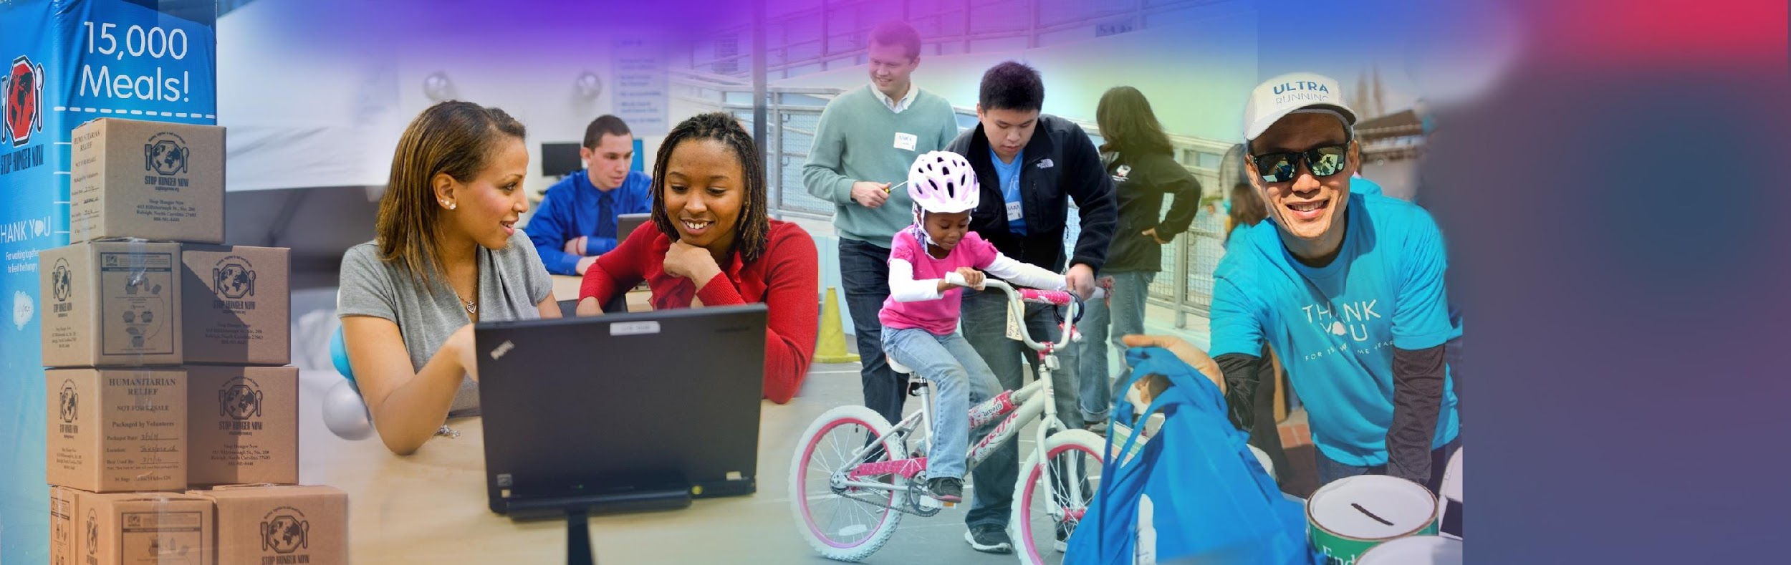















Celebrating 16 Years of Giving Back
1% Product
1% Equity
1% Time
26K⁺
$96M⁺
1.1M⁺
Nonprofits & Higher Ed
Grants
Service Hours
Sharethemodel.org
1-1-1 Model Adopted by
Notes:
DONE - Jay L - Get actual slide from Dana McNulty
Key Takeaway:
Salesforce has also been a pioneer with our innovative Philanthropy to go along with our technology model. Our 1-1-1 (equity, time and product) has been successful and adopted by Google, Workday, etc.
ACTION: Provide personal philanthropy activity
Talk Track:
Salesforce has always been about a new technology model with the cloud; a new pay-as-you-go business model; but we've also created a new philanthropic model. This model is a 1-1-1 model where we give 1% of our equity, employees time, and product to non-profits.
Our 1-1-1 model has been so successful that companies like Google, Dropbox, Workday and Yelp have also adopted it.
We’ve given over 680,000 hours of community service, $68 million in grants have come out of the foundation, and 23,000 nonprofits use our products.
Personally, I am involved in… [Insert personal story here]

Slide 5
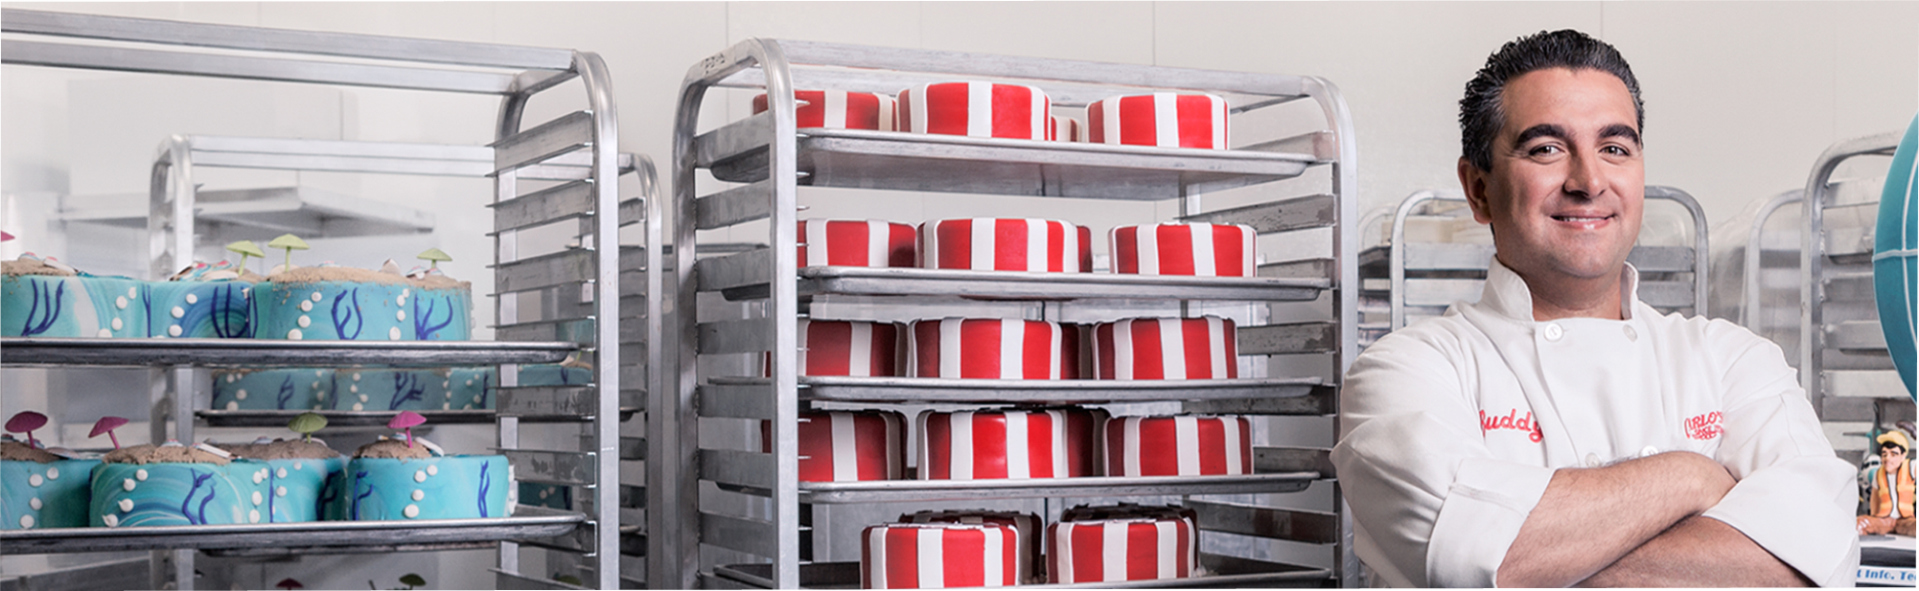
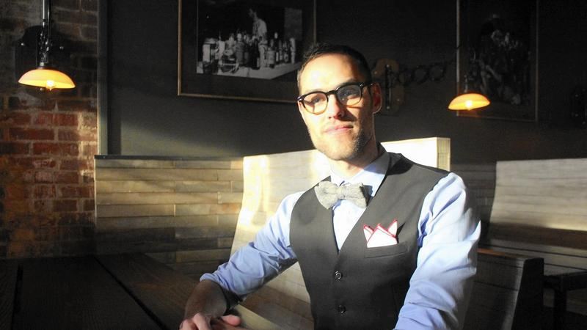






Open for Service
"I think there's an opportunity to take a negative and make it a positive."
Josh Driver, Founder, Open for Service
2.5k
27k
~1k
Started in March 2015 by Josh Driver
Directory of Equality-Minded Businesses open to all customers (regardless of sexual orientation, religion, race, etc)
Members (purchased $10 stickers)
~5,000 businesses (50% in Indiana, 7 countries beyond US)
Data in various formats - Directory difficult to maintain & present
Notes:
DONE - Jay L - Take from video quote from josh
N/A - Eric - Pass final draft by Josh for any input

Slide 6
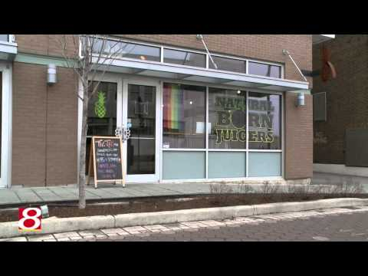
Open for Service
In the news...
Notes:
DONE, YT public - Jay L - Add screenshot, pull down video locally and embed, and get permission

Slide 7

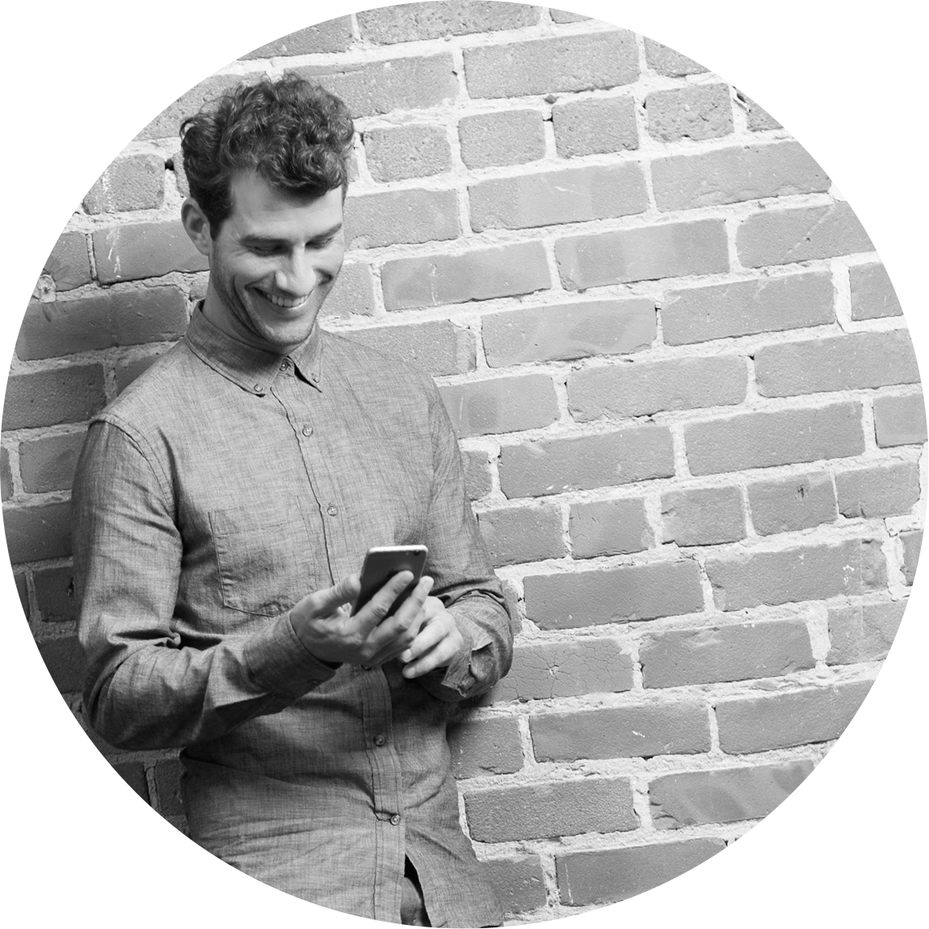




The Gap
Customers
looking for businesses who are open to everyone...
Businesses
OPEN to EVERYONE
Notes:
The gap is between businesses wanting to spread the concept for openness to all and the customers who they might serve. Current solution is spread out over various services, some free, some cloud, etc. Data is in various formats and in varying levels of completeness.

Slide 8

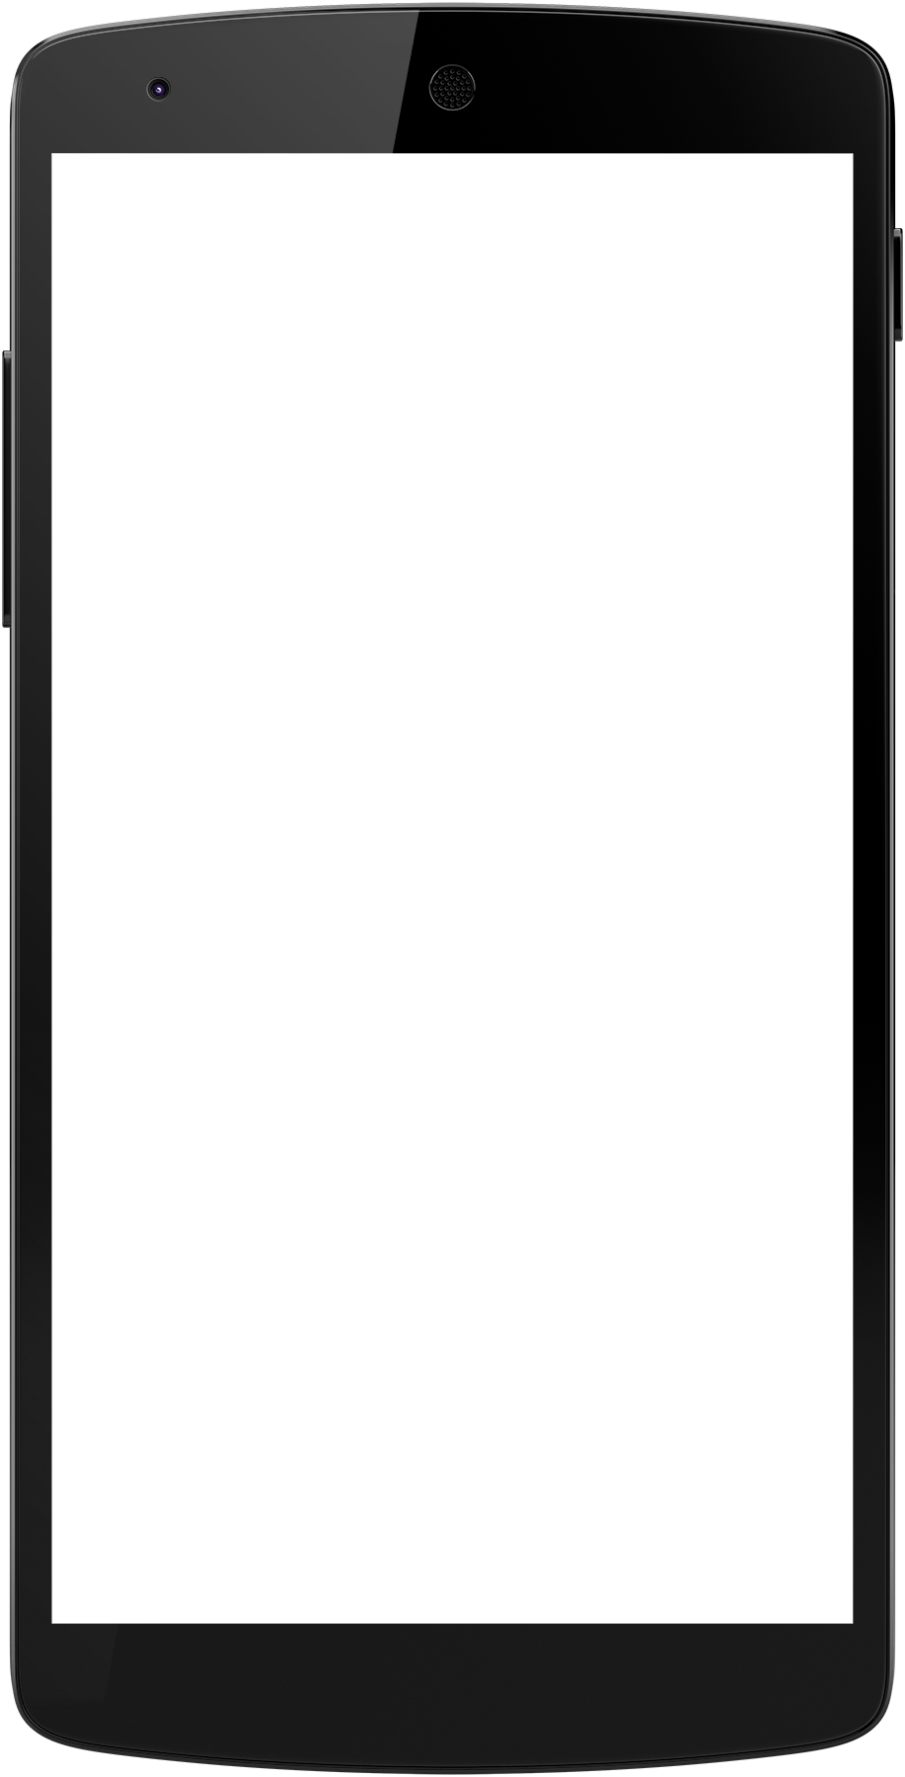





A foundation to support rapid growth
A single cloud of truth
Sales Cloud
Accounts
Contacts
Cases
Donations
Marketing Cloud
E-Mail
MobileConnect (SMS)
Mobile Push
Apps
Heroku
Heroku Connect

Slide 9
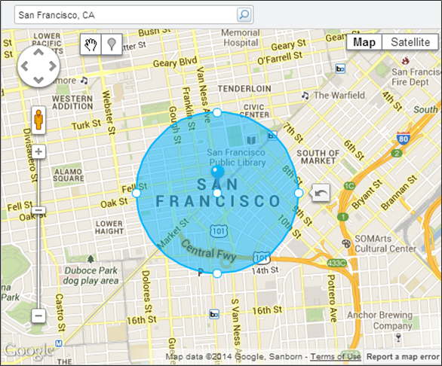
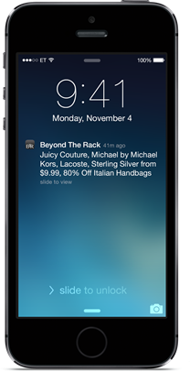
MobilePush
Reaching an audience on-the-go
Push Notifications via:
Google Cloud Messaging
Apple Push Notifications
App Usage Statistics
Rich Push using CloudPages
Location-based Marketing (including Beacons!)
Message Inbox
Notes:
Eric - Add more about mobile push, leveraging content canvas from other areas, targeted audiences
Eric - Send to Rachel for tweaks week after dry run

Slide 10
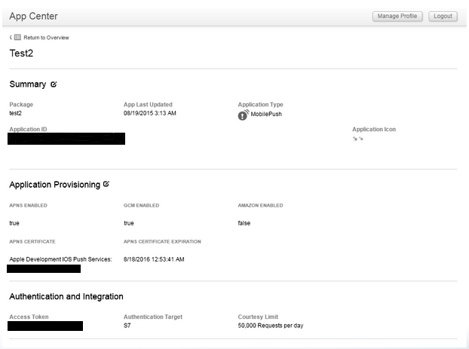

Code Example 1 - Mobile SDK for Apps Integration
But it says “false”...
Which token again?
Error...really?
Testing:
cUrl & Automation Studio
http://bit.ly/o4sdf15
Notes:
Eric - Add linked lessons learned and testing guides

Slide 11

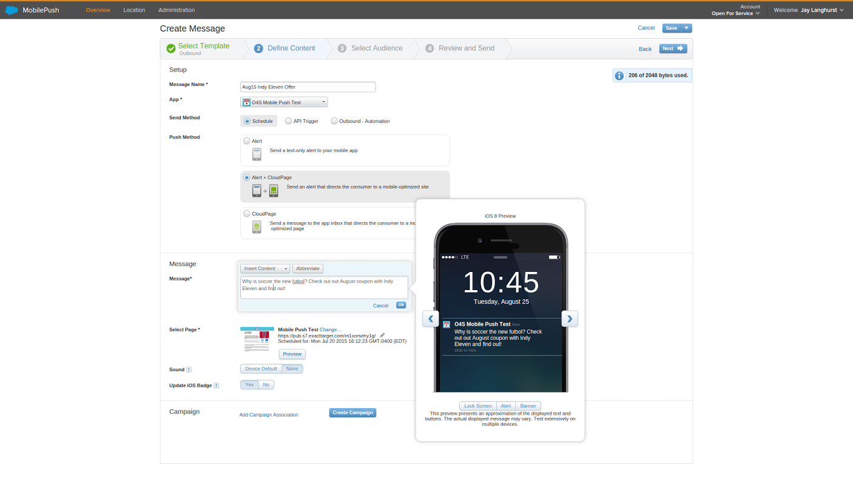
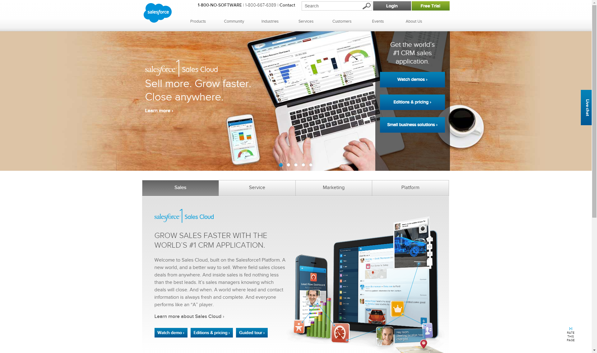
Demo - Composing a MobilePush Message
Push Methods Available:
Alert
Alert+CloudPage
CloudPage
Preview appearance in iOS and Android
Notes:
DONE - Jay - Add screenshot and update key points

Slide 12
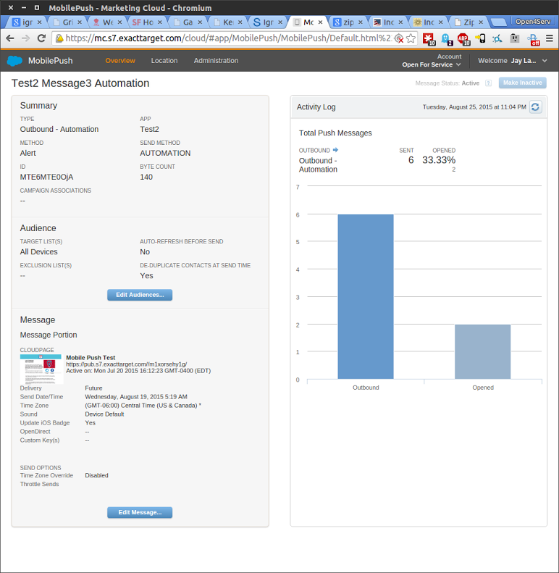
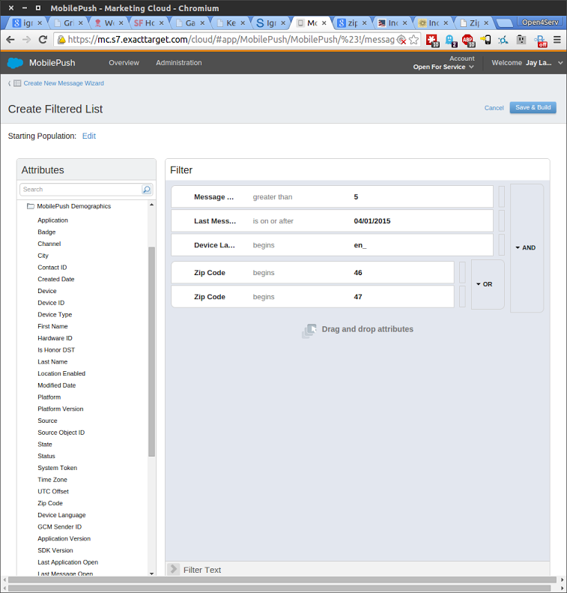
List Filtering & Delivery Reporting
Segment Audience using standard and custom data
Throttle sends if manual processes are involved
Run reports for export of subscriber and message activity
Notes:
DONE - Jay - Add screenshot and update key points

Slide 13
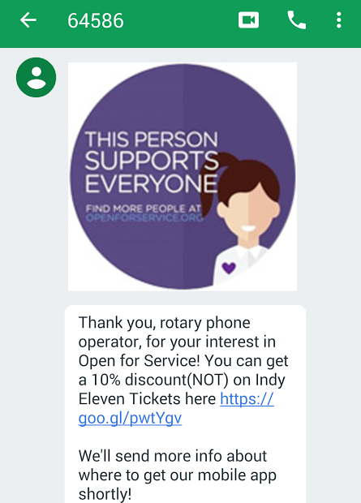
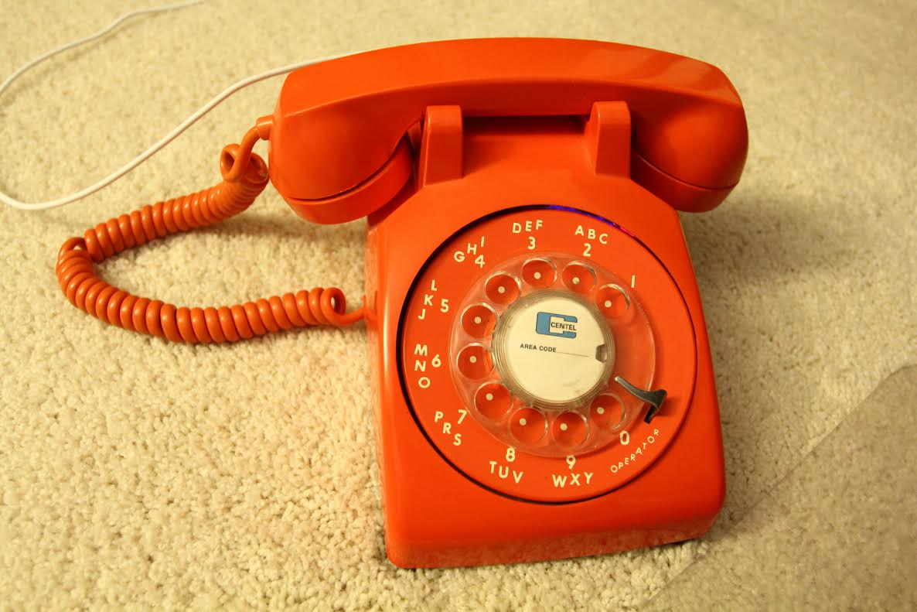
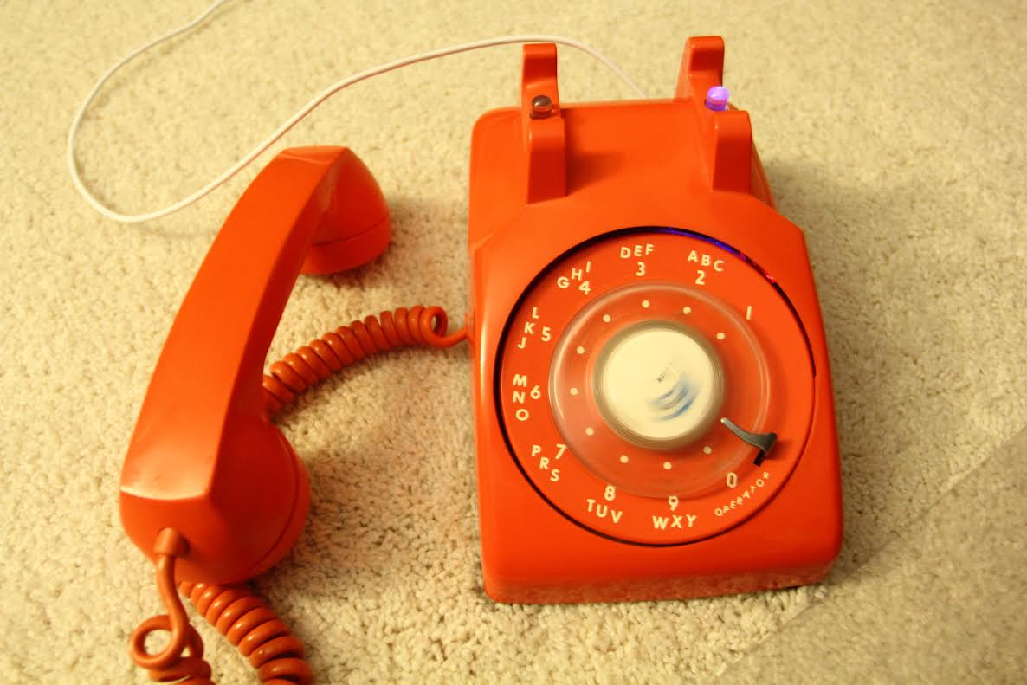


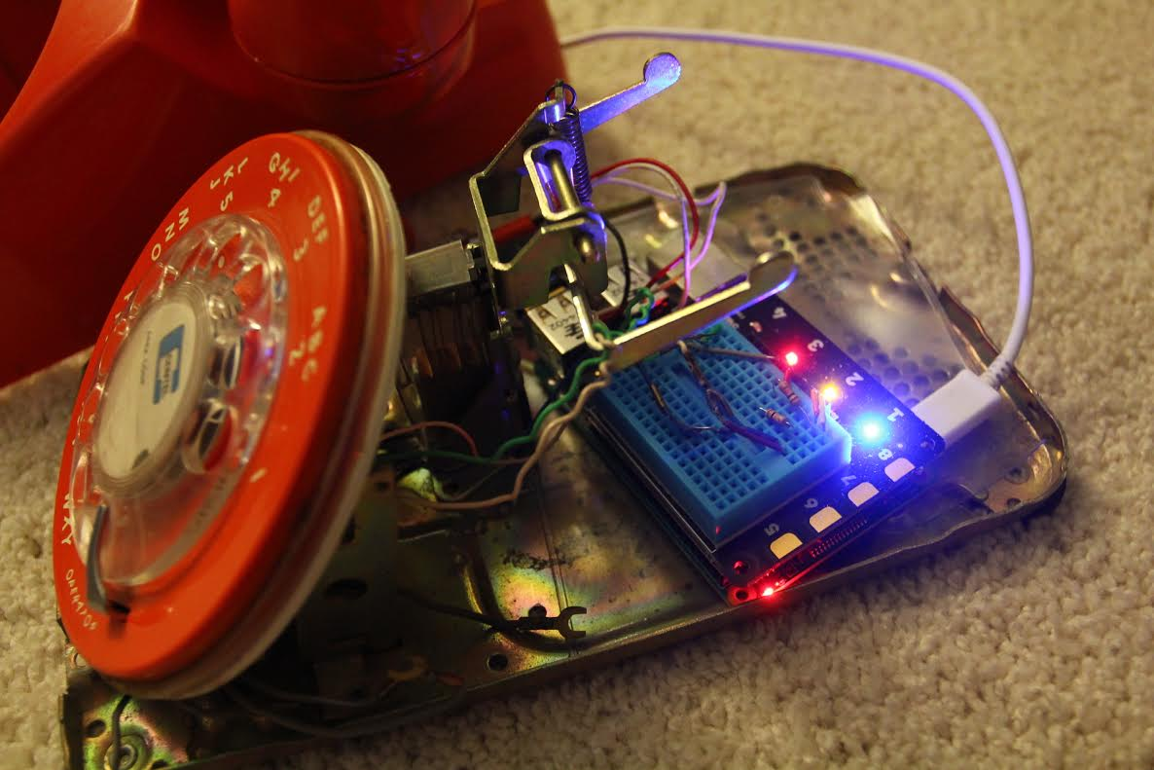
Internet of Things - Rotary Phones
Analog to Digital
Phone is located at one of the Open for Service Businesses with beacon to alert nearby app users
Instructions by phone engage new and existing users to dial their own cell number
New users get easy download link, existing users get mobile push with coupon offer from that business
Notes:
DONE - Jay L - Replace images with photos from launch at end of August

Slide 14
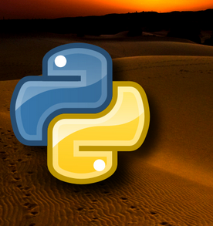
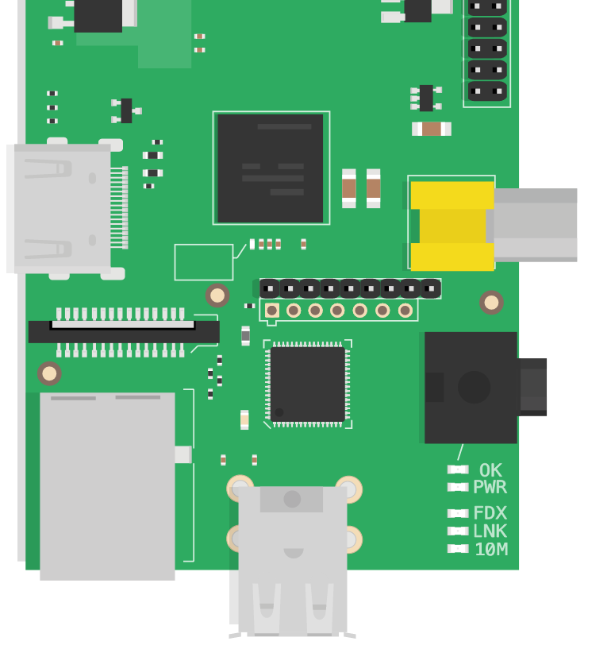
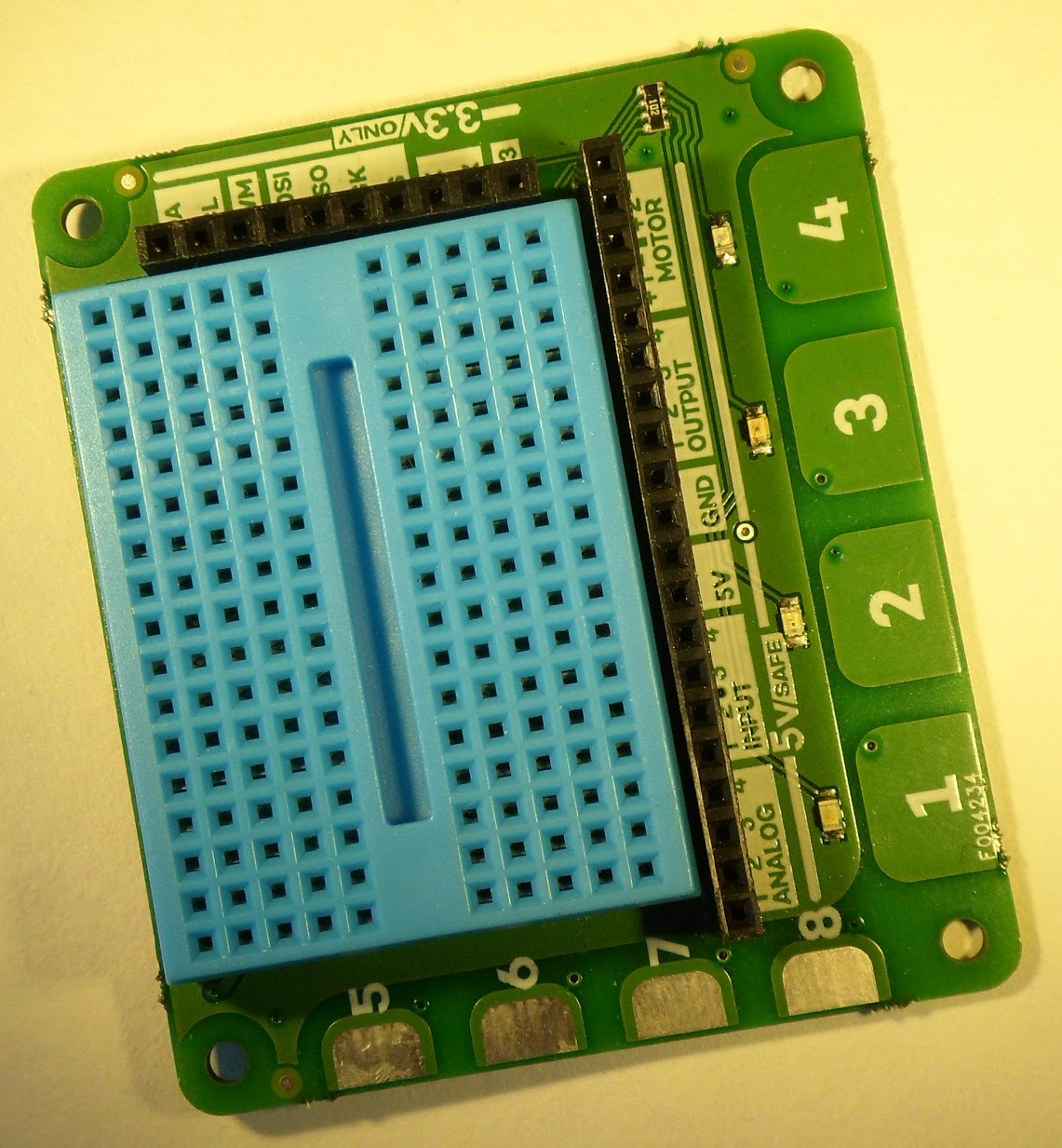
Internet of Things - Rotary Phones
Analog to Digital
Raspberry Pi - Cheap Linux computer ($35)
Explorer HAT / Breadboard circuit stacks on top of Raspberry Pi for safe and easy connection to Rotary phone with indicator lights
Python to:
Interpret phone numbers dialed
Call Marketing Cloud APIs
Notes:
DONE - Jay L - Replace images with photos from launch at end of August
https://commons.wikimedia.org/wiki/File:Raspberry_Pi_Vector_Illustration.svg#/media/File:Raspberry_Pi_Vector_Illustration.svg
https://www.flickr.com/photos/45703688@N07/16666811179/
http://orig07.deviantart.net/9c33/f/2011/173/e/a/python_wallpaper_03_by_petux7-d3joc98.jpg

Slide 15

Try it out in person!
App download - Text OPENAPP to 64586
Open for Service - openforservice.org or @Open4Serv on Twitter

Slide 16
Questions?
Also check out --
IoT section of the DevZone
Connected product demos including the Rotary Phone

